Slide 1
Virtual Memory
Chapter 8

Slide 2
Memory Hierarchy
cache
virtual memory
CPU
C
a
c
h
e
Memory
8 B
32 B
4 KB
disk
regs
Register
Cache
Memory
Disk Memory
size:
speed:
$/Mbyte:
line size:
32 B
1 ns
8 B
32 KB-4MB
2 ns
$125/MB
32 B
1024 MB
30 ns
$0.20/MB
4 KB
100 GB
8 ms
$0.001/MB
larger, slower, cheaper

Slide 3
Types of Memory
Real memory
  Main memory
Virtual memory
  Memory on disk
  Allows for effective multiprogramming and relieves the user of tight constraints of main memory

Slide 4
Virtual Memory Properties
A process may be broken up into pieces that do not need to be located contiguously in main memory
No need to load all pieces of a process in main memory
A process may be swapped in and out of main memory such that it occupies different regions
Memory references are dynamically translated into physical addresses at run time
Advantages:
  More processes may be maintained in main memory
  With so many processes in main memory, it is very likely a process will be in the Ready state at any particular time
  A process may be larger than all of main memory

Slide 5
A System with Virtual Memory (paging)
Memory
0:
Page Table
1:
Virtual
Addresses
Physical
Addresses
0:
1:
CPU
P-1:
N-1:
Disk
Address Translation: Hardware converts virtual addresses to physical addresses via OS-managed lookup table (page table)

Slide 6
VM Address Translation
Parameters
  P = 2^{p} = page size (bytes).
  N = 2^{n} = Virtual address limit
  M = 2^{m} = Physical address limit
n–1
p
p–1
0
virtual page number
page offset
virtual address
address translation
m–1
p
p–1
0
physical page number
page offset
physical address
Page offset bits don’t change as a result of translation

Slide 7
Paging
Each process has its own page table
Each page table entry contains the frame number of the corresponding page in main memory
A bit is needed to indicate whether the page is in main memory or not

Slide 8
Execution of a Program
Operating system brings into main memory a few pieces of the program
Resident set - portion of process that is in main memory
An interrupt is generated when an address is needed that is not in main memory - page fault
Operating system places the process in a blocking state and a DMA is started to get the page from disk
An interrupt is issued when disk I/O is complete which causes the OS to place the affected process in the Ready Queue

Slide 9
Page Faults
  Page table entry indicates virtual address not in memory
  OS exception handler invoked to move data from disk into memory
    current process suspends, others can resume
    OS has full control over placement, etc.
Before fault
After fault
Memory
Memory
Page Table
Page Table
Virtual
Addresses
Physical
Addresses
Virtual
Addresses
Physical
Addresses
CPU
CPU
Disk
Disk

Slide 10
Servicing a Page Fault
Processor Signals Controller
  Read block of length P starting at disk address X and store starting at memory address Y
Read Occurs
  Direct Memory Access (DMA)
  Under control of I/O controller
I/O Controller Signals Completion
  Interrupt processor
  OS resumes suspended process
(1) Initiate Block Read
Processor
Reg
(3) Read Done
Cache
Memory-I/O bus
(2) DMA Transfer
I/O
controller
Memory
disk
disk
Disk
Disk

Slide 11
Thrashing
Swapping out a piece of a process just before that piece is needed
The processor spends most of its time swapping pieces rather than executing user instructions

Slide 12
Principle of Locality
Program and data references within a process tend to cluster
Only a small portion of a process will be needed over a short period of time
Possible to make intelligent guesses about which pieces will be needed in the future
Therefore, principle of locality can be used to make virtual memory to work efficiently

Slide 13
Support Needed for Paging
Hardware support for address translation is critically needed for paging
OS must be able to move pages efficiently between secondary memory and main memory (DMA)
Software/Hardware support to handle page faults

Slide 14
VM Address Translation
Parameters
  P = 2^{p} = page size (bytes).
  N = 2^{n} = Virtual address limit
  M = 2^{m} = Physical address limit
n–1
p
p–1
0
virtual page number
page offset
virtual address
address translation
m–1
p
p–1
0
physical page number
page offset
physical address
Page offset bits don’t change as a result of translation

Slide 15
Page Tables
Virtual Page
Number
Memory resident
page table
(physical page
or disk address)
Physical Memory
Valid
1
1
0
1
1
1
0
1
0
Disk Storage
(swap file or
regular file system file)
1

Slide 16
Address Translation
page table base register
virtual address
n–1
p
p–1
0
VPN acts as
table index
virtual page number (VPN)
page offset
valid
modify
physical page number (PPN)
if valid=0
then page
not in memory
m–1
p
p–1
0
physical page number (PPN)
page offset
physical address

Slide 17
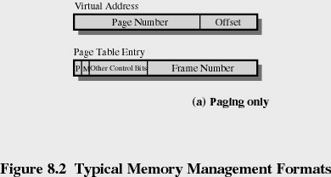
Page Table Entries
Modify bit is needed to indicate if the page has been altered since it was last loaded into main memory
If no change has been made, the page does not have to be written back to the disk when it needs to be swapped out

Slide 18
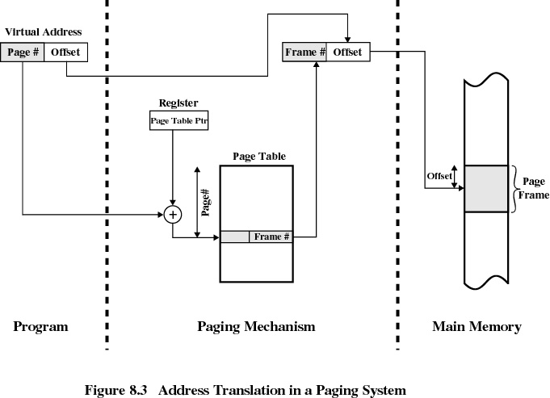

Slide 19
Page Tables
The entire page table may take up too much main memory
Page tables are also stored in virtual memory
When a process is running, part of its page table is in main memory

Slide 20
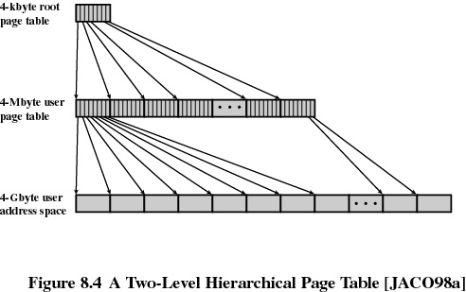
Two-Level Scheme for 32-bit Address

Slide 21
Multi-Level Page Tables
Given:
  4KB (2¹²) page size
  32-bit address space
  4-byte PTE
Problem:
  Would need a 4 MB page table!
    2²⁰ *4 bytes
Common solution
  multi-level page tables
  e.g., 2-level table (P6)
    Level 1 table: 1024 entries, each of which points to a Level 2 page table.
    Level 2 table: 1024 entries, each of which points to a page
Level 2
Tables
Level 1
Table
...

Slide 22
Translation Lookaside Buffer
Each virtual memory reference can cause two physical memory accesses
  one to fetch the page table entry
  one to fetch the data
To overcome this problem a high-speed cache is set up for page table entries
  called the TLB - Translation Lookaside Buffer
TLB stores most recently used page table entries

Slide 23
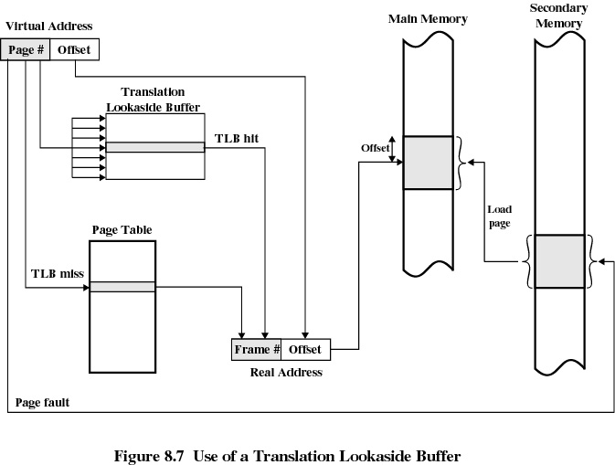

Slide 24
Translation Lookaside Buffer
Given a virtual address, processor examines the TLB
If page table entry is present (a hit), the frame number is retrieved and the real address is formed
If page table entry is not found in the TLB (a miss), the page number is used to index the page table

Slide 25
Translation Lookaside Buffer
TLB uses associative mapping (i.e. many virtual page numbers map to the same TLB index).
Therefore, VP numbers are also stored to be looked for a match
Memory management system first checks if page is already in main memory
  if not in main memory a page fault is issued
TLB is updated to include the new page entry

Slide 26
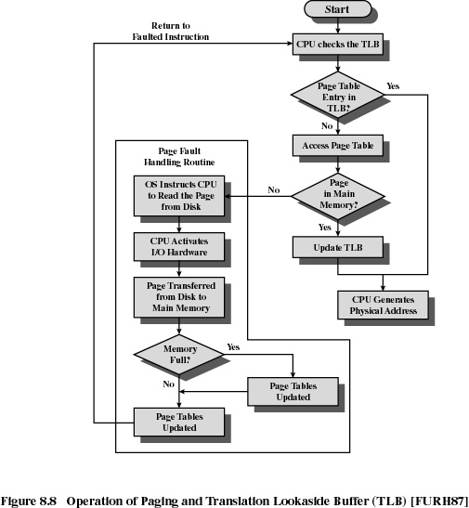

Slide 27
Page Size
Smaller page size ➔ less amount of internal fragmentation (due to the last page of a process)
Smaller page size ➔
more pages required per process
More pages per process means larger page tables
Larger page tables means large portion of page tables in virtual memory (i.e. double page faults possible)
Secondary memory is designed to efficiently transfer large blocks of data which favors a
larger page size.

Slide 28
Page Size
Small page size ➔ large number of pages will be found in main memory
As time goes on during execution, the pages in memory will all contain portions of the process near recent references ➔ Page faults low.
Increased page size causes pages to contain references which may not be resident in memory (because fewer number of page frames is allowed per process)
➔ Page faults may rise.

Slide 29
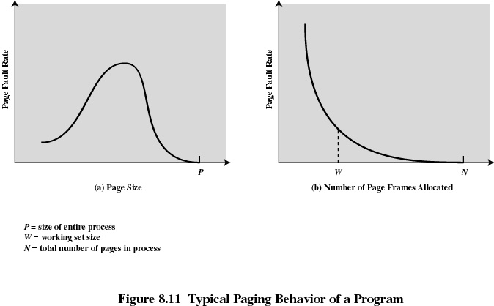

Slide 30
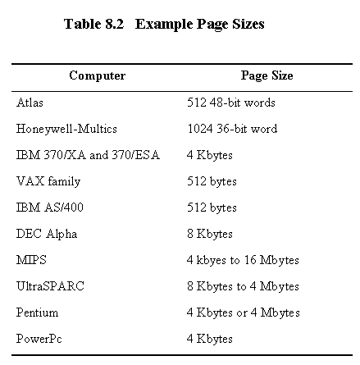
***here Example Page Sizes

Slide 31
Fetch Policy
Determines when a page should be brought into memory
Demand paging only brings pages into main memory when a reference is made to a location on the page
  Many page faults when process first started
Prepaging brings in more pages than needed
  More efficient to bring in pages that reside contiguously on the disk

Slide 32
Replacement Policy
Which page should be replaced?
  Page that is least likely to be referenced in the near future
  Most policies predict the future behavior on the basis of past behavior
Frame Locking
  If frame is locked, it may not be replaced
  Kernel of the operating system
  Control structures
  I/O buffers
  Associate a lock bit with each frame

Slide 33
Basic Replacement Algorithms
Optimal policy
  Selects for replacement that page for which the time to the next reference is the longest
  Impossible to have perfect knowledge of future events
Least Recently Used (LRU)
  Replaces the page that has not been referenced for the longest time
  By the principle of locality, this should be the page least likely to be referenced in the near future
  Each page could be tagged with the time of last reference. This would require a great deal of overhead.

Slide 34
Basic Replacement Algorithms
First-In, First-Out (FIFO)
  Treats page frames allocated to a process as a circular buffer
  Pages are removed in round-robin style
  Simplest replacement policy to implement
  Page that has been in memory the longest is replaced
  These pages may be needed again very soon

Slide 35
Basic Replacement Algorithms
Clock Policy
  Additional bit called a use bit
  When a page is first loaded in memory, the use bit is set to 0
  When the page is referenced, the use bit is set to 1
  When it is time to replace a page, the first frame encountered with the use bit set to 0 is replaced.
  During the search for replacement, each use bit set to 1 is changed to 0

Slide 36
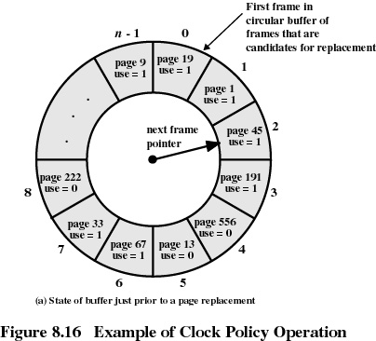

Slide 37
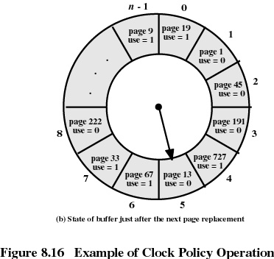
page 1
use = 1
use: 1 => 0
use: 1 => 0
Page 556 is replaced with page 727 and
use bit is set to 1

Slide 38
Resident Set Size
Fixed-allocation
  gives a process a fixed number of pages within which to execute
  when a page fault occurs, one of the pages of that process must be replaced
Variable-allocation
  number of pages allocated to a process varies over the lifetime of the process

Slide 39
Variable Allocation, Global Scope
Easiest to implement
Adopted by many operating systems
Operating system keeps list of free frames
A free frame is added to resident set of process when a page fault occurs
If no free frame, replaces one from another process

Slide 40
Variable Allocation, Local Scope
When a new process is added, allocate to it a number of page frames based on application type, program request, or other criteria (resident set)
When a page fault occurs, select a page from among the resident set of the process that suffers the fault
Reevaluate allocation from time to time.
Increase/decrease allocation to improve performance

Slide 41
Load Control
Determines the optimum number of processes that should be resident in main memory
As multiprogramming level increases, processor utilization rises
Too few processes ➔ higher probability for all processes to be blocked
➔ too much time spent in swapping
Too many processes ➔small resident set ➔ thrashing

Slide 42
Process Suspension
If multiprogramming level is to be reduced,
then, some processes must be suspended.
Suspend:
Lowest priority process
Faulting process
  will soon be blocked anyway
  high probability that it does not have its working set in main memory

Slide 43
Process Suspension (cont.)
Some more good choices for suspension…
Last process activated
  this process is least likely to have its working set resident
Process with smallest resident set
  this process requires the least future effort to reload
Largest process
  generates the most free frames making future suspensions unlikely

Slide 44
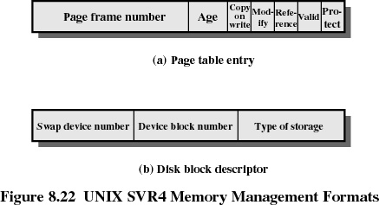
UNIX & Solaris Memory Management
Page table (one per process with one entry for each virtual page of the process)
Disk block descriptor (for each page of a process. Describes the disk copy of the virtual page)

Slide 45
UNIX and Solaris Memory Management
Page Replacement
  refinement of the clock policy
Kernel Memory Allocator
  kernel generates and destroys small tables and buffers frequently during the course of execution
  most blocks are smaller than a typical page size therefore the paging mechanism would be inefficient to use
  SVR4 uses a modification of the buddy system.

